Slide 1
Unit 5 -
Coder Etiquette

Slide 2
Bell Work
Please come up with an idea for a fake website real fast. It can be fake or unrealistic.
I will give you 10 minutes, write down a few important aspects of the site including:
Describe your business/site in a few sentences.
Who is your target audience?
Who are your main competitors and what do you like about their sites?

Slide 3
Students will learn to create an SDLC (software development life cycle) by communicating needs and limitations with clients for working on an example client site
Today’s Objective

Slide 4
SDLC 101
An SDLC, when used correctly, will ensure that the client gets what they want, that the end users are happy with a functioning product, and the coders have a clear list of things that need to be added.
This can be misused and cause frustration and wasted time for everyone involved. Please take these seriously

Slide 5
SDLC 102
Think of the SDLC as a contract that you make with your client so that you know what they want and they know your direction.
It protects you just as much as them, if the client tries to say that you did a bad job you can turn to the SDLC and show them why you did what you did.

Slide 6
If you were creating a legal document for work you were going to do what information would you need?
Question
Hands Up / Random Call-Ons
Notes:
There are 4 important things, a what - the content or product that will be delivered. a when - deadlines for when everything is due. A who - who is agree to this, with a signature involved perhaps. And a how - how much money will be given for the product.

Slide 7
Step 1 - Planning
Before you code anything you plan ahead and agree on terms

Slide 8
Listen to the client
When you first meet with a client you need to introduce yourself and meet each other for a second.
Share your name and ask theirs, ask about their business and try to get make it a nice experience for them.

Slide 9
Find out about THEIR plan
They already have an idea that’s why they hired you
ask them about what they want to do with their site.
Let them talk and while you take some notes here and there to ask about later.
This will answer a lot of the questions on your SDLC if you pay attention.

Slide 10
Follow up Questions
Now that you have heard their ideas, taken some notes about concrete ideas or must haves, you have the opportunity to ask some questions of your own.
This should not turn into a 20 questions marathon but it is important that you the information that you need.
On the next slide I will talk to you about a few strong questions to get the answers you need

Slide 11
Question 1
Describe your business in a few sentences.
This is not always required if the introduction to the team goes well.
If there is still a lot of base information that you need from them then this is a great start to the conversation.
From here you can ask them to clarify, but you should not interrupt their talking, simple comments are a nice way to keep the comments going

Slide 12
Question 2
What are some make or break design items for you?
Can you provide an example site that you like?
There can be some items that the client NEEDS
Search bars, credit page, no footers, no ad space etc.
They may not have any items that they can think of to love or hate, that is when you ask the follow up question for examples to use as reference.

Slide 13
Question 3
Who is your target audience?
This should tell you more about the layout and the styles that you are going to use.
If it’s for kids you want more open space and less content
If it’s for engineers you want big words and sharp angles. Etc…
This will mostly just be for reference to keep you on brand

Slide 14
Question 4
Can you give me a list of features that your site requires and describe how they will be interacted with by the user?
For instance if they want a shopping cart, should it be always visible, have its own page, or just be a small pop up on the top?
If you are asking for a quantity of something should you use use a box, a slider, radio buttons, or something else?
This may also be nothing but you should try to press them if you see something that could variations

Slide 15
Question 5
What is the time frame of this project? When would you need this done by?
This is going to be a bit of a conversation, you will have to be honest here and really tell them your ability to meet their expectations
Have a conversation about what they can drop from their wants or if they are able to give you more time to work. This includes possible flexible pay.

Slide 16
Your Last Chance
After you have heard about the project, what they want in it, what the time frame is and what the user interactions are required, You get to decide if you want the job or not.
You need to be honest with yourself, if they are asking too much then find a new client and don’t waste your time with them.
Sometimes a bad client is not worth any amount of money.

Slide 17
Please spend 30 ish minutes completing the “planning” portion of the SDLC with your shoulder partner. This will be based on the website you created during belwork.
USE THE QUESTIONS AND TREAT THIS LIKE IT IS A REAL CLIENT!!
Activity

Slide 18
Web Design
Now that you have thought about it, create it

Slide 19
Designing
Now that you have an idea of what the site is about and what it needs to hold, you need to work with the client to design their dream site
Again, this is a collaboration. If there is something that you think they are doing wrong you need to tell them
Don’t be afraid to add or remove things, just make sure you ask permission first.

Slide 20
Mock ups
A mock-up is a hand drawn rough draft of the site that you are going to be building.
This is usually done with the client and looks incredibly messy.
Things will be added and removed, feel free to cross those out or scribble and then when you and the client are happy with the outcome redraw it.
You can use words or other pens to mark colors aswell

Slide 21
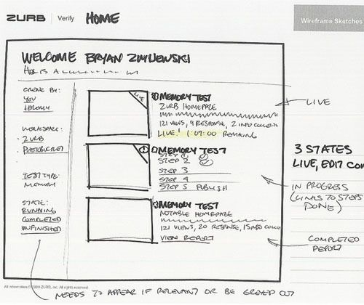
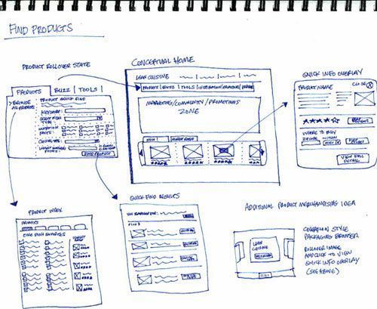
Mock-ups

Slide 22
Mock-ups
These are important to document!!
This is where you get crucial input from the client about the final product and you are obligated to make it similar to that, and they are obligated to pay you for your time.
If you come to the client at the end and they hate it you can show them what you agreed on and see what they would like to fix.
Think of this as a non-legal contract that makes sure the client and yourself both get the desired outcome.

Slide 23
Mobile Design
This will work very similar to the other mockup but now you need to reposition everything to fit on a phone screen.
Make sure you consider if you need to delete/hide anything like content or pictures to make room.
This will also affect colors and design.
Document this just like the web version

Slide 24
Please work on the wireframe in the “design” section for your SDLC for both the web and mobile versions.
Your partner should be doing ALL of the drawing for your site, help them to create your vision with words only.
Activity

Slide 25
Step 2 - Development
Time to get to started

Slide 26
Development
Not much to say here, you do your job and code.
If you do something controversial or you realize that something looks bad in practice then reach out to that main contact and ask what to do.
Always check in once in a while with updates on how the project is going, this will keep them happy and in the loop and also keep you honest with the time frame.

Slide 27
DOCUMENT EVERYTHING
Make little comments about the work you are doing and the decisions that you made along the way.
Make notes on the original design about changes but do not replace the originals.
If it is something important that will take time it make even be a good idea to have the client sign off on it.
This is to protect you not just help the client

Slide 28
Step 3 - Stabilizing, Patching & Testing
Quality Assurance

Slide 29
Testing
Testing is quality assurance
Here you try everything in an attempt to find bugs and vulnerabilities so that you can patch them out.
There are professionals that do this for a living but for smaller projects you can do it yourself.
It is important to try and use the code in an unintended way.

Slide 30
Error Handling
When you find an error you should:
Make a note of it in the SDLC
Make sure your team is aware so that they can plan on fixing it before it is released to the client
Assign someone to the task of fixing it
Mark down when it was fixed and by who
Retest it it thoroughly to make sure there aren’t more errors

Slide 31
Step 4 - Delivery to the Client
Making sure QA is done and then return the work to the client

Slide 32
Presentation
This can look like many things but most likely the client has not seen whole site or all of the functionality so you need to give them a tour
You should use the planning part of the SDLC to show that you added everything they asked for and demonstrate the page navigation
If there are more complex functions be prepared to demo the site as well.

Slide 33
Delivery
If all goes well then the client will be happy and they will accept the site from you, you will get your full pay and everyone will be happy
If something goes wrong this could be where you go back to the development and fix something for the client that they hated.
You should not be changing everything, maybe just a few little updates.
If they want a full site rework, they will need to pay you for that. (this is what the SDLC is for)

Slide 34
Step 5 - Operations and Maintenance
Update, fix, and maintain

Slide 35
The Aftermath
Some clients will ask you to stay on and keep updating the site, working on new stuff for them or just be available by phone if things go wrong.
Even if they don’t offer it you can give them your number and let them know that you can fix or update the site if they ever need it.
If you build up a large client base this can be a full time job on its own and with 10+ companies all paying you to be available you can make a lot

Slide 36
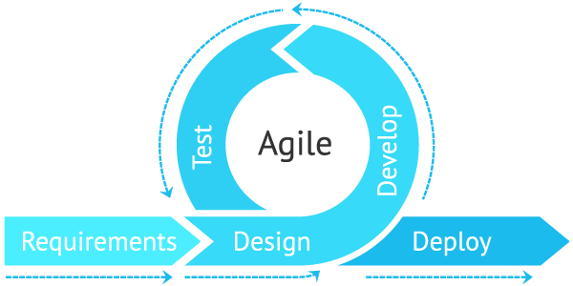
Agile Development
How to be a better developer

Slide 37
Agile Intro
This is a specific form of development and is currently the most used version across the world
As the name implies this is a form of development that is flexible so that it can be used for any project
This form of development focuses very heavily on the user experience and client collaboration

Slide 38
The Agile Values
Individuals and Interactions
Instead of just focusing on the project and what needs to be done you can focus on the team and how they do it
If you have a happy team and they are all working together very well then the product will turn out better
This also goes with the client, if you have a good relationship with the customer the project has a better chance for success

Slide 39
The Agile Values
Working Software
While testing and creating your project you should make it available to everyone
Many older companies would spend their time creating rendered images of the site and typing up instructions on how to use the site
You should instead have it up so that people can see and use it while push out consistent updates.

Slide 40
The Agile Values
Customer Collaboration
By keeping constant communication with the client and customers you can ensure that you are creating what they want to receive and what will be best for the users
This will also avoid large changes or unfortunate miscommunications at the end of the project

Slide 41
The Agile Values
Responding to change
Unlike other forms of design, agile is based around the idea that at any point the entire project and scope can change
People’s needs, modern design, software and the team you are working with change constantly and your project needs to be able to change with all of that

Slide 42
The Agile Principles
These are your 12 commandments while working on your SDLC and you better believe this will be on your test in some capacity.
Your highest priority is to satisfy the customer through early and continuous delivery of valuable software
Welcome changing requirements, even late in development. Agile processes harness change for the customer’s competitive advantage

Slide 43
The Agile Principles
3. Deliver working software frequently, from a couple of weeks to a couple of month, and as needed.
4. Business people and developers must work together daily throughout the project
5. Build projects around motivated individuals. Give them the environment and support they need, and trust them to get the job done.

Slide 44
The Agile Principles
6. The most efficient and effective method of conveying information to and within a development team is face-to-face conversation
7. Working software is the primary measure of progress
8. Agile Processes promote sustainable development. The sponsors, developers, and users should be able to maintain a constant pace indefinitely
9. Continuous attention to technical excellence and good design enhances agility

Slide 45
The Agile Process
10. Simplicity, the art of maximizing the amount of work not done, is essential
11. The best architectures, requirements, and designs emerge from self-organizing teams.
12. At regular intervals, the team reflects on how to become more effective, then tunes and adjusts its behavior accordingly

Slide 46
Please go through every single one of these principles and write a sentence or two where we used that yesterday during the activity or an example that given during the notes.
Check for understanding

Slide 47
Color Theory
When and how to use colors

Slide 48

Which of these hands looks like it’s on top and which one looks like a hole was cut in the background? Why do you think that is?
Bellwork

Slide 49
Basics
Primary Colors
Secondary Colors
Tertiary Colors
Yellow-orange
Yellow-green
Blue-green
Blue-violet
Red-violet
Red-Orange
Red
Yellow
Blue
Orange
Green
Violet

Slide 50

Warm Colors
Warm colors are what you think of on a nice fall sunny day.
These are energy colors and make people want to take action

Slide 51
Warm Colors
These colors will draw attention and seem to pop out, especially when they are placed on a cool background

Slide 52
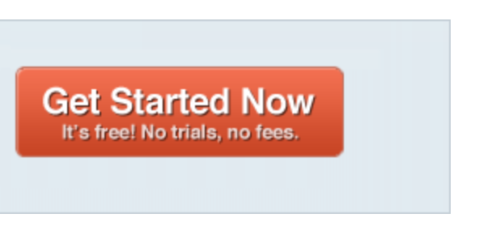
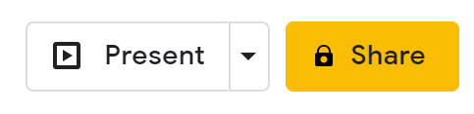
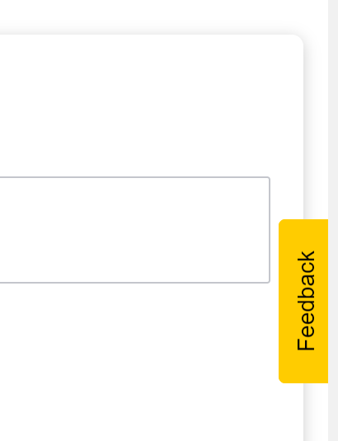
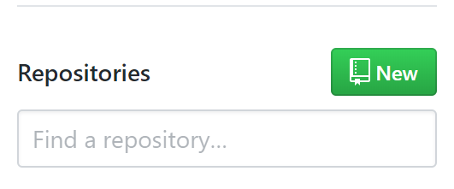
Action Items
Action Items are smaller parts or your site that you want to draw the user’s attention to.
These can be buttons, tabs, or important information

Slide 53

Cool Colors
These are more calming and likely what you would use in a background.
Since these don’t push someone to action they are not often used for action items but if combined with a white background any color will draw attention

Slide 54


Monochromatic
A monochromatic site uses only 1 color with varying shades and tints
This can lead to a feeling of unity throughout your site and depending on the color can also prompt your users to prejudge your site in certain ways.

Slide 55
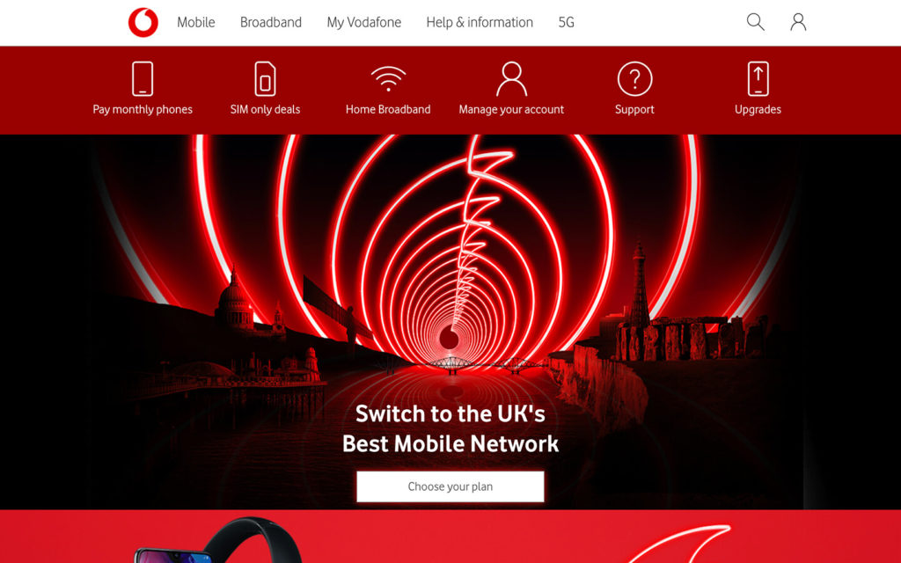
Example

Slide 56


Slide 57
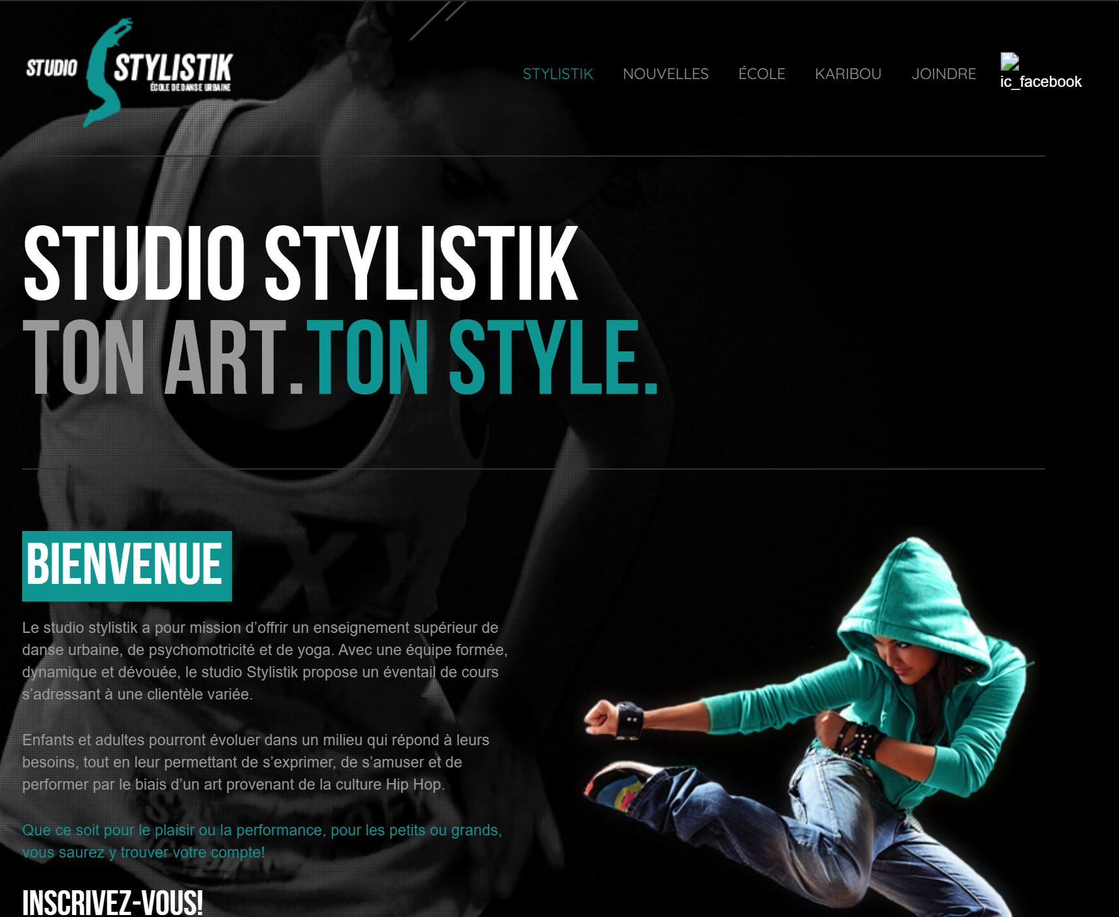

Slide 58


Complimentary Colors
These are colors that are on the opposite sides of the color wheel.
When used together they really pop and the warm colors will REALLY stand out on top of the complimentary cool color.

Slide 59
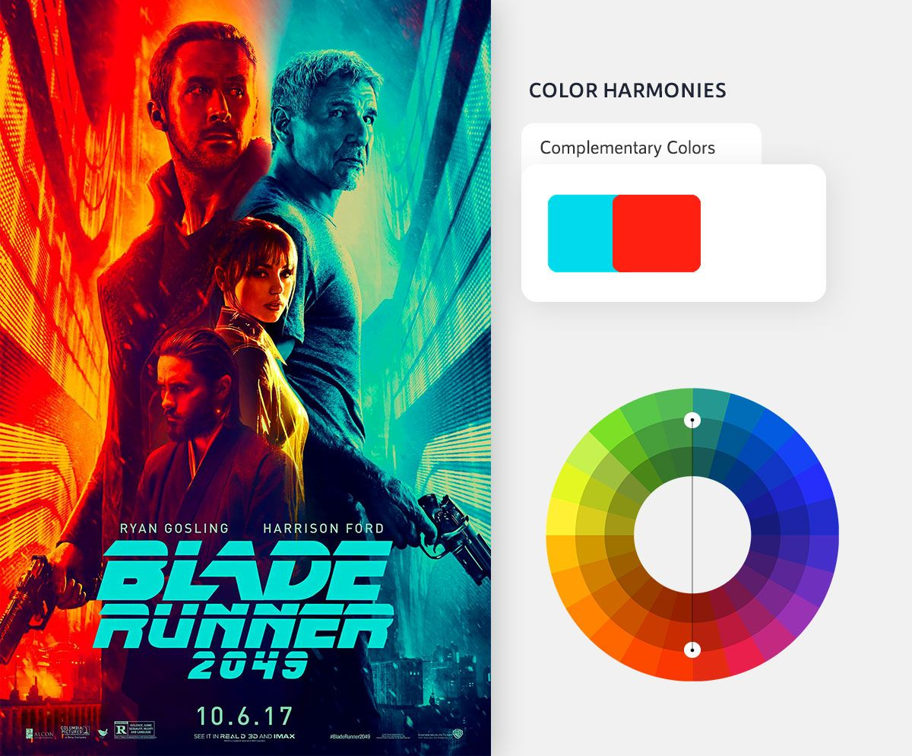
Example
When used together they can create a stark contrast that will highlight a divide between subjects

Slide 60
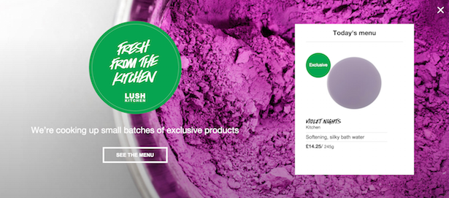
Website Example

Slide 61
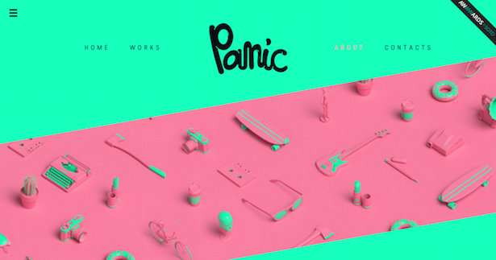
Website Example

Slide 62
Split-Complementary Colors
This is a much more common use of colors for a website.
This will still give you strong contrast like before but will also give more choices to choose from
Just like last time the subject of the page or the item that you want users to pay attention to should be the single complimentary color

Slide 63

Question Time:
Do not call out.
What color would you make an item that you really want to stand out on this poster?

Slide 64
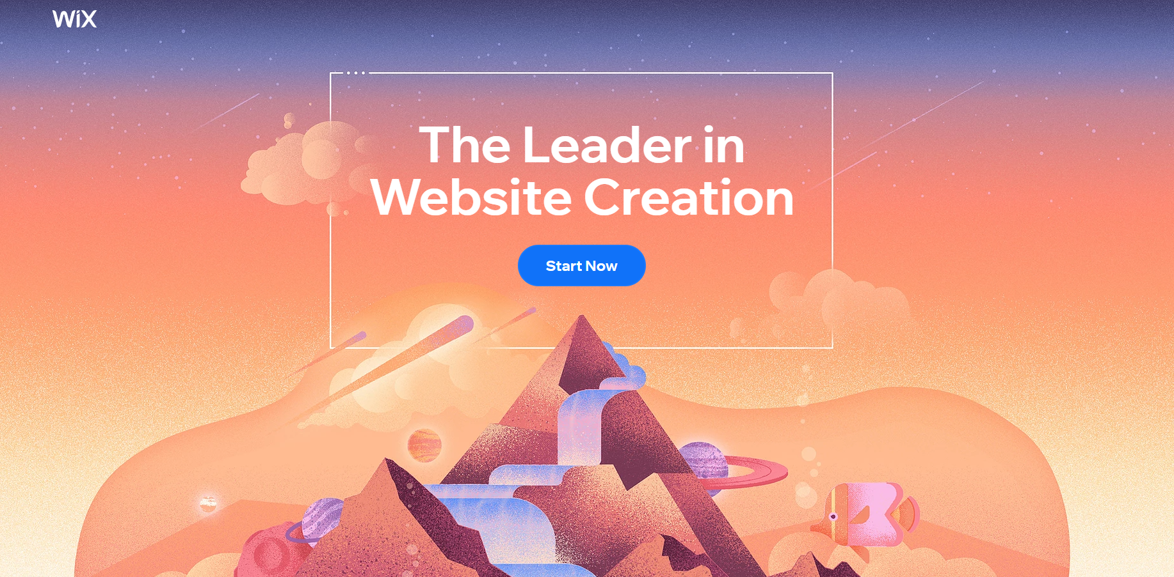
Website Example

Slide 65
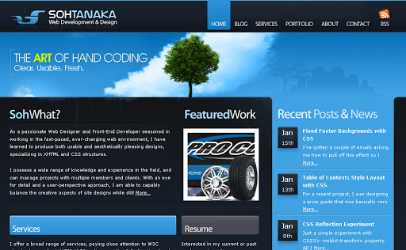
Website Example

Slide 66
Achromatic Color
One of the more common design choices. This can lead to very professional and clean looking web design.
Achromatic is where you only use black and white (and shades between) and then throw in a color to highlight the action item
Be Careful, the color you use will say a lot about the theme of your site

Slide 67


Slide 68
Website Example

Slide 69

Website Example

Slide 70
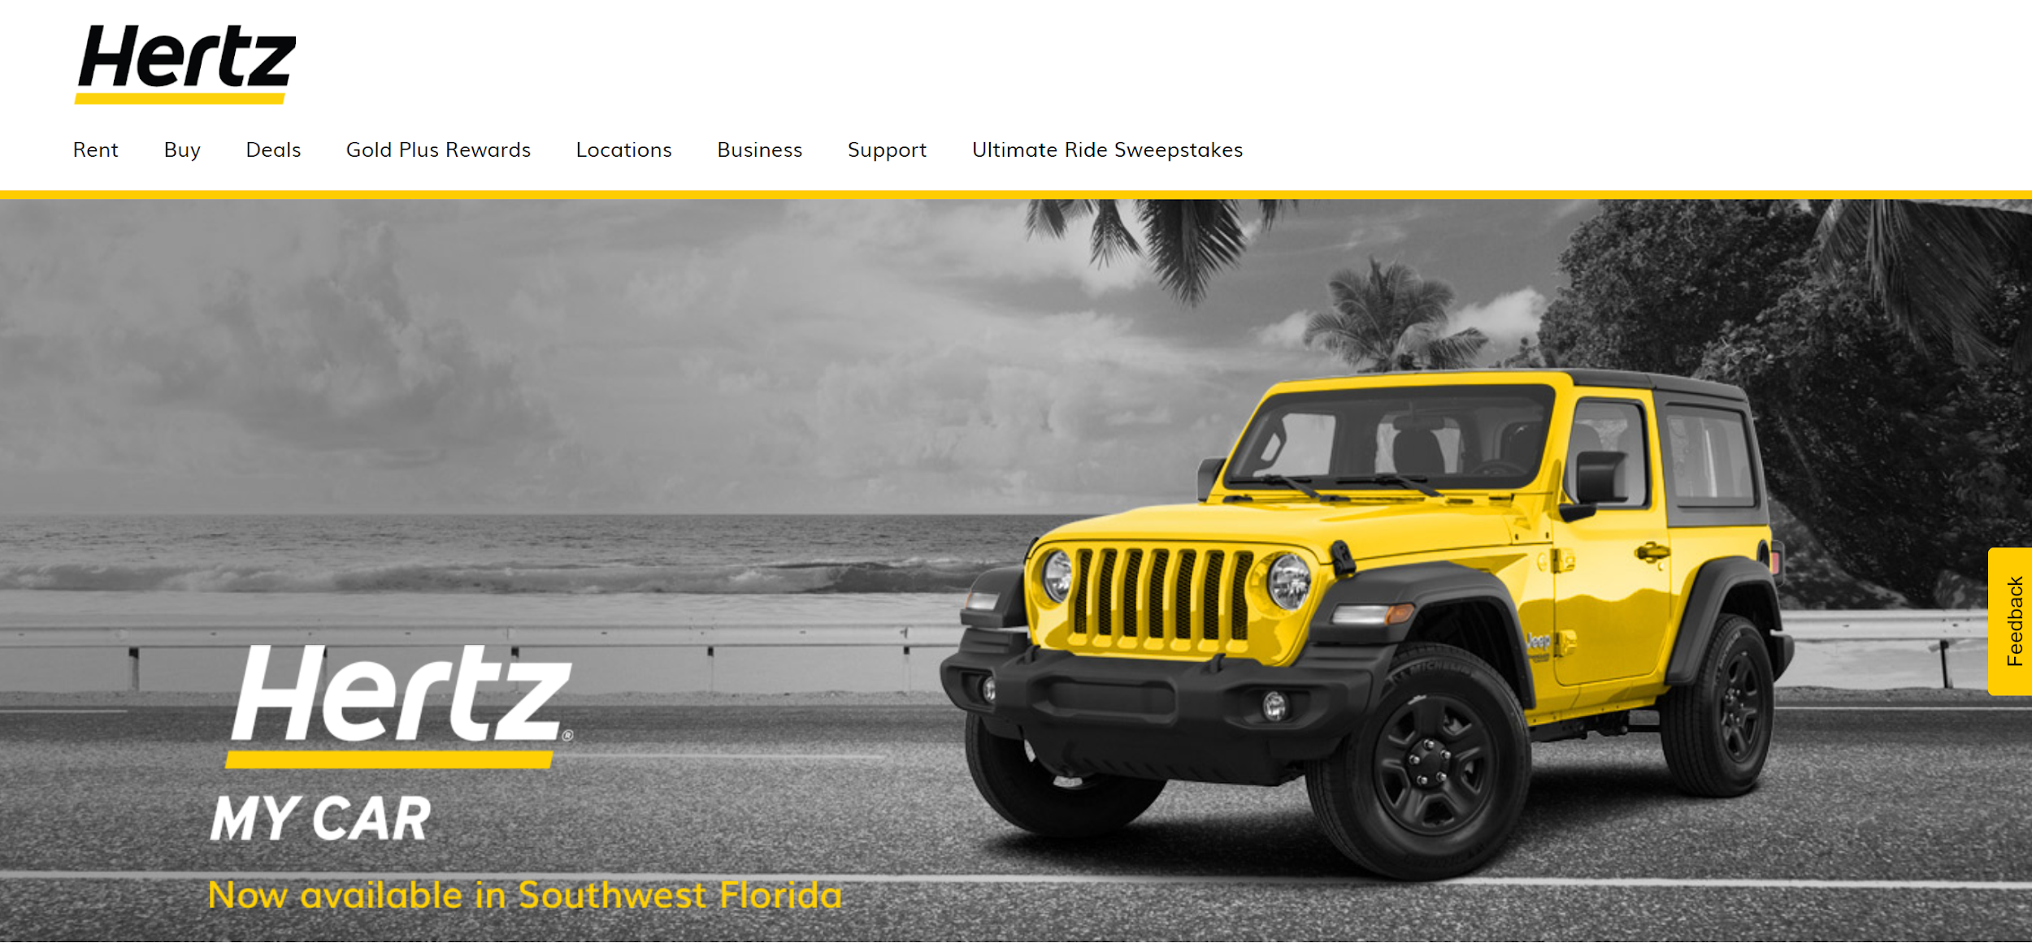
Website Example

Slide 71
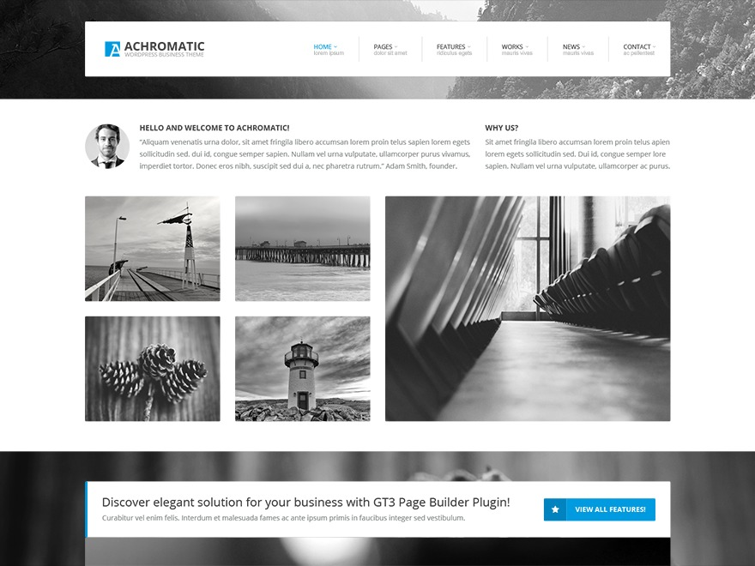
Website Example

Slide 72
Triatic and Tetradic Colors
These are site with 3 or 4 colors that are spread throughout the color wheel.
When using this kind of color scheme the site will look very busy and lively.
These are good for sites that you want to have a more exploratory feel, people need to look around to find the important parts on their own instead of having the path told to them

Slide 73
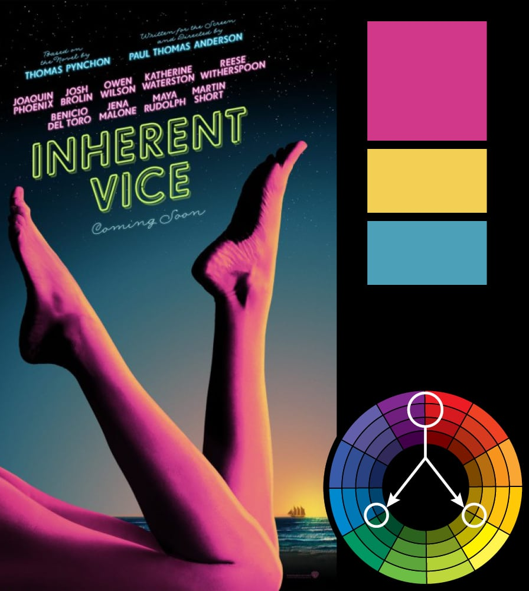
Example
This is a vivid poster with a lot of energy.
Text was made to look like neon lights to fit that theme with the colors

Slide 74

Website Example

Slide 75
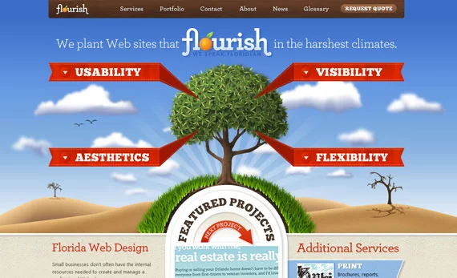
Website Example

Slide 76
Color Feel
Some feels that can be associated with colors. Not all the feels.

Slide 77
Activity part 1
Everyone will be given one of the base 6 colors.
For your color please look up and find 10 companies that use that color in the majority of their site and or logo.
For example orange could use West-Mec

Slide 78
Activity part 2
Take each of those businesses and write down 3-5 attributes about each one.
These can be facts, verbs, or adjectives. Don’t avoid overlapping the words, it is ok for all of them to share an attribute.
Example: West-MEC - learning, students, friendly, careers, and collaboration.

Slide 79
Activity part 3
Take your attribute lists and try to find some similarities.
Look for attributes that are shared by 3 or more businesses and write them down.
These are are potential feelings, emotions, or ideas that can be conveyed with that color.

Slide 80
Activity part 4
Get with the other students who shared the same color for the activity and try to make a full comprehensive list.
The more common an attribute is the higher it should be on your list.
Choose 1 member of your team that will present these ideas to the class.

Slide 81
Red - incase you missed any
Intense action, good or bad
Passion
Love
War
Danger
Fire
Strength

Slide 82
Orange
Warmth and youth
Stimulating
Creative
Success
Summer
Enthusiasm
Fun

Slide 83
Yellow
Happiness and Speed
Joy
Intellect
Energy
Attention-getting
Sunshine
Fast

Slide 84
Green
Growth, plants, and wealth
Nature
Money
Healing
Freshness
Life

Slide 85
Blue
Tranquility and safety
Peace
Masculine
Trustworthy
Secure
Stability
Refreshing

Slide 86
Purple
Royalty and power
Mystery
Wealth
Ambition
Nobility
Confidence

Slide 87

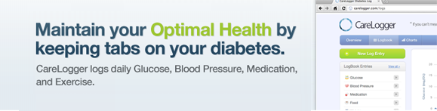
The power of color
Changing this wording and highlighting the key words in GREEN a color we know means health to people raised the amount of people who clicked on their sign up by 31%

Slide 88

The power of color
Changing the sign up button from green to red created urgency and raised it another 34%

Slide 89
The power of words
Lastly they changed the words on the button from “Sign up for free” to “Get started now”
This improved it another 7%
With these 3 small changed they were able to increase the amount of people who visited their site and signed up by 72%
The words did not change much, people see color more than they read words

Slide 90
Color Pickers
Please google color picker and open the first two links. These can be a great tool for figuring out a color scheme.
Htmlcolorcodes.com
imagecolorpicker.com
If you know one of the colors use color codes
If you know the subject then you can place that in the image selector and look at some possible colors

Slide 91
Try it out
Please look up a picture of a puppy, use that picture in the image color picker to find the main colors
Take one the colors that you think matches and that you want to use and place that in the color codes site to find more along those lines.
Write down your theme

Slide 92
I want you to think of a nice color scheme for the following businesses
Business 1 - a company that sells cupcakes
Activity

Slide 93
I want you to think of a nice color scheme for the following businesses
Business 2 - a company that promotes fitness
Activity

Slide 94
I want you to think of a nice color scheme for the following businesses
Business 3 - a company that sells energy drinks
Activity

Slide 95
Logo Design / Slogans

Slide 96
Go back to the website/business that you designed on Monday.
Think of an item, idea, shape, or design for your business that you can place as a logo.
Bellwork

Slide 97
What Makes a Strong Logo
A strong logo is simple to copy without a computer, a child should be able to recreate it with some accuracy.
It should be easily recognizable, is someone has seen it once they should recognize it the next time they see it.
It should also reflect an idea or message to your audience.

Slide 98
Tip # 1 - Know Your Brand
How do you want to people to think or you at first sight
Are you a tough brand for rugged outdoor hikers?
Are you a softer brand for selling baked goods?
tough brands are usually more simple designs, opting for geometric lines while softer brands will use use a recognizable image or a more complicated picture

Slide 99







Athletic and Outdoor brands
What are some similarities you see?

Slide 100







Less Active or Indoor Brands What do you notice here?

Slide 101
Tip #2 - Reflect the Nature of Your Business
What do you want to share with people about your business?
Example - You may want a car because you business is speedy, now
is your car a ferrari because it is fancy,
is it a futuristic car because you deal in technology, or
is it a green hybrid because you have a focus on nature and sustainability?

Slide 102


What are some common themes you see between all of these logos?
Why do you think that is?

Slide 103

Tip # 3 - Impression is Crucial
The first time someone sees your logo should be enough to have the recognize it later in the day.
An easy way to test this is show someone your logo and then give then 3-4 similar ones later in the day. Which one did you see?
If they can guess it you have a logo with a strong impression

Slide 104





Let’s see if these were effective
Which of these were on the travel slide?
Notes:
Bottom left, blue diamond. And top right, sunny adventure

Slide 105
Tip #4 - Use Color in a Planned Way
We went over color earlier in this, please use those similarly when creating your logo.
The color can do a lot but most importantly if should be bright to draw attention to it.
If it drove by on a bus someone it should catch someone's eye
Don't pick random colors, these can say a lot about your brand

Slide 106
Tip # 5 - Pick Font Carefully
The font you pick should reflect the business, the target audience, and the branding
Use a fun, cursive font for a whimsical winter theme
Use a strong, bold font for a rock/metal music group
If you use a really strong font it can be part of your logo
Ex. No matter what you write in star wars font you know it's from star wars.
coca-cola, minecraft, and disney are all great examples

Slide 107
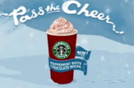




Christmas Fonts

Slide 108
Practice
Describe a font that you would use for a coffee company
What traits should the font have? What colors should you use?
Now Describe a font that you would for a construction company
List traits like above
Write a sentence or two on why these are so different.

Slide 109
Tip # 6 - Chose the Type of Logo
Do you want an image or do you want text or maybe you can turn your text into a design.
This is an important question for a small or unknown business.
Many businesses these days are combining the name of the company into the branding, this sames on advertising since everything you brand will also have your company name on it.

Slide 110
Tip # 7 - Keep it Simple
When creating a logo it should only use 1 or 2 colors, an object, a single font, etc.
If there is too much going on then it could muddle the message that you are trying to present to your customers.
A very clear concise design will give meaning
Ex. Google has simplest logo ever but it good and memorable

Slide 111

Tip # 8 - Make it Scalable
You should create several designs for the same logo that will be used on different sized ads or merchandise
This can be the same but put thought into it

Slide 112
Tip # 9 - It Should Be Impressive Without Color
There will be many situations where your logo may need to be black and white.
Make sure that your logo does not look like a black blob or a picasso drawing when reduced to black and white.
Many people suggest creating a colorless logo first and then filling in color after

Slide 113






Practice

Slide 114







Slide 115
Go look at the logo you designed for bellwork.
Tell why it is still a good design using the 9 tips you learned or recreate it using the 9 tips you learned
Activity

Slide 116
Slogans
I’m Lovin’ it

Slide 117
Highlight an Effective Benefit
Why your company the best for what it does?
Does it do anything different from the competitors that a customer would care about?
What is the company’s general mission?
Judgement-Free zone
Because you’re worth it
The breakfast of Champions

Slide 118
Explain the company’s Commitment
What do you care about as a business?
A few Examples include
Best customer service
Highest quality food
Fastest Service
1-Day Delivery
What is the focus of the business that you are “commiting” to your customers before they sign up

Slide 119
Keep it short
This should be a small sound bite no longer than a 5 words so people can get it stuck in their heads.
The more you can say with fewer words the better.
Just Do It
We got the meats
Where’s the beef
I’m Lovin’ it

Slide 120
Give them a Rhythm
This doesn’t mean that you are going to make them with rhyming words but give them a rhythm that can be “sang”
I’m Lovin’ it
Do you Yahoo
Give me a break
That was easy
He keeps going and going…
Can you hear me now? good.

Slide 121
Stay Honest
Do not say that you have the best food around when your real focus is on having the fastest food around.
If your slogan is a lie people will turn on you very quickly
Sometimes it is better to promise nothing so that you can be wrong
A diamond is forever
Every kiss begins with K
Where’s the Beef?
Probably the Best Beer in the world

Slide 122
Create a slogan for your business. Then write why you think it is a good slogan to represent your product or business
Activity

Slide 123
Photo Editing
Let’s wrap up this unit

Slide 124
Pixlr.com
This is a photoshop lite website that lets you do all kinds of editing on your browser with no download required.
Please go to this site and use pixlr E edition. They are both free and work similar but E has more tools for you to use. There is no reason to use X.

Slide 125
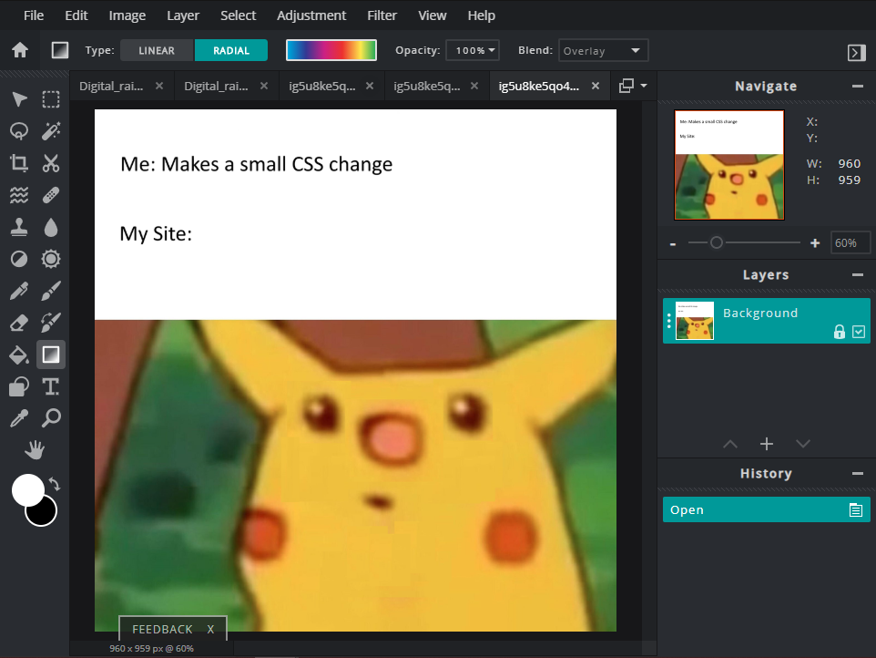
Pixlr Basics
Tool Options - Most tools have several ways to operate, this is where you change that
Navigation and Layers- Where you choose your work space
Toolbox - where you choose how you want to interact with the image

Slide 126
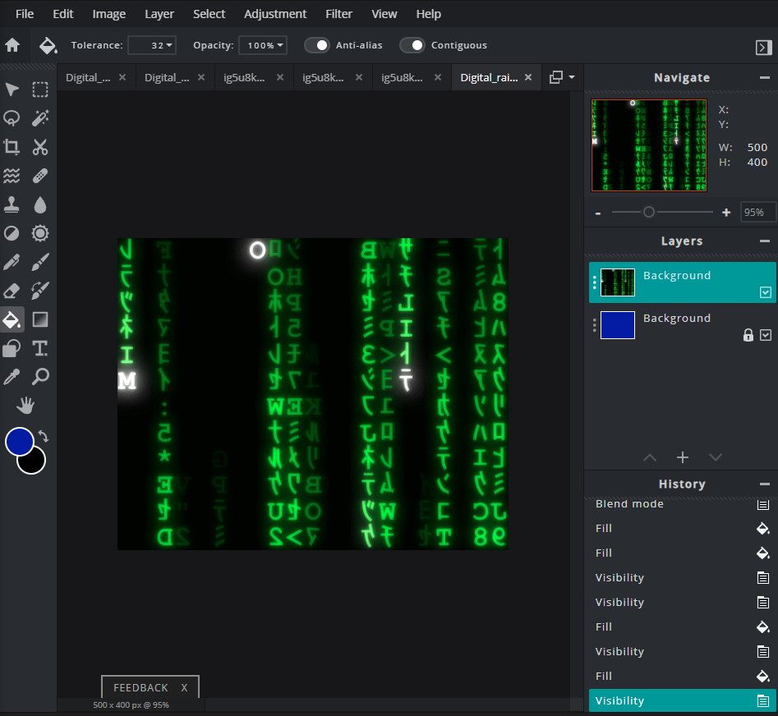
Tutorial
Please download the image from GC and use it to follow along
Unlock the background layer,
Create a new layer,
Paint that layer blue
place it at the bottom of the list
Rename it to background
Lock the background layer
Rename the original to letters

Slide 127
SAVE THIS PICTURE FOR REUSE
We are going to be reloading this a lot for practice

Slide 128
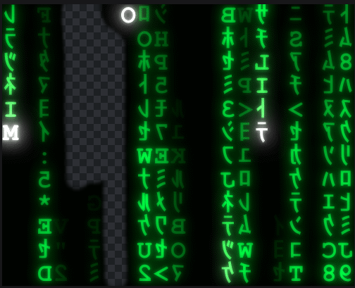

Removing Parts
You can select any part of your image and delete it if you want to reveal the empty space beneath
Play around with the settings and see if you can remove most of the black space between the green

Slide 129
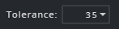
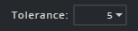


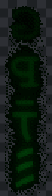
Removing Parts
When using the magic wand you may notice that it also selects some of the darker green letters
To fix this you can change the Tolerance to a lower value

Slide 130
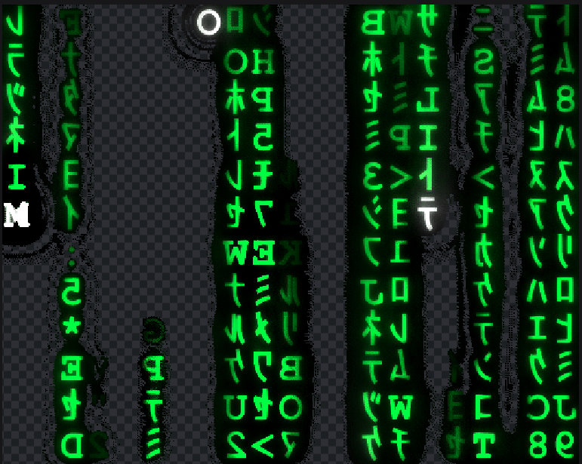

Sharpening the Picture
First you can remove all the blurry pixels around the letters by darkening the midtones
Then you can make the letters brighter by lightning the highlights

Slide 131
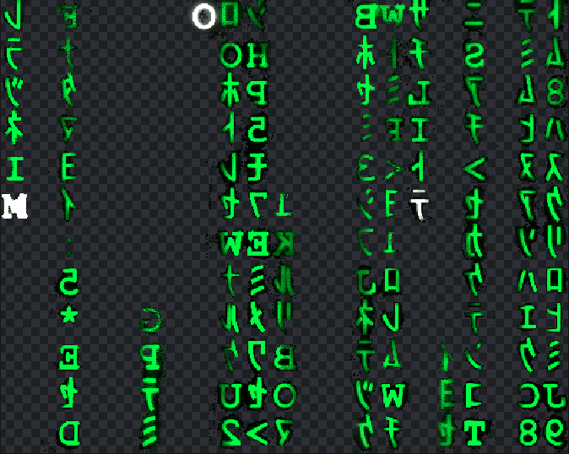
Clean up
Using the cutting tool and the brighten / darken feature do your best to clean up the rest of the background

Slide 132
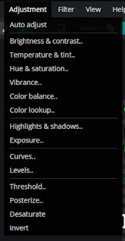
Color and Shade
You can change the colors and saturations
Hue changes the colors so you can make the green into any other color
Saturation can remove the color making it into grey scale if you want that.
Feel free to play around a little here

Slide 133
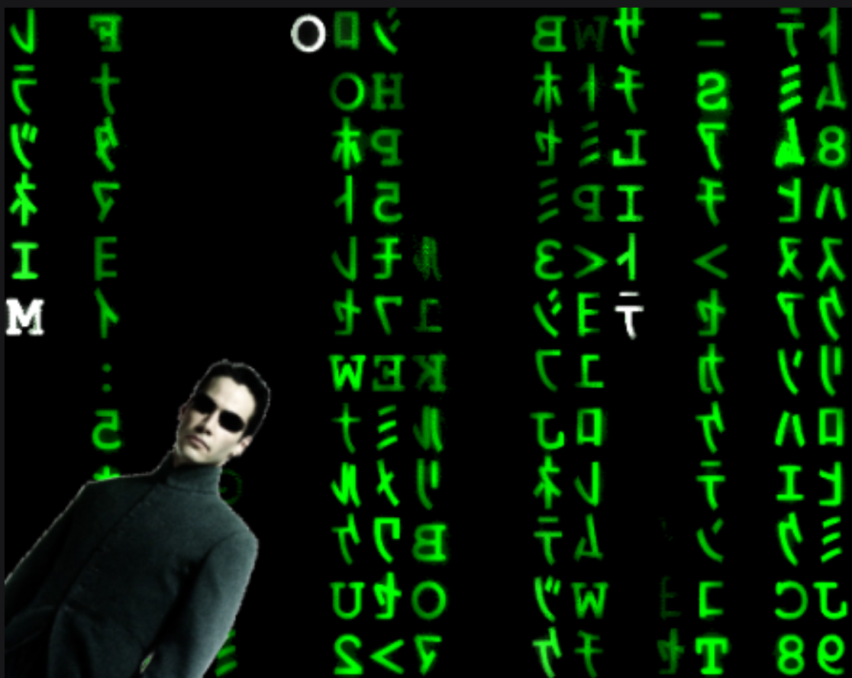
Adding Images
Use a new layer and add another image on there of Neo from the matrix
Have some fun with it. Add as much as you want and make the colors what you feel like

Slide 134
Use your new found skills to create a scene that is happening.
I want something/someone who is fighting/riding/running from something else. Then add a creative background for all of this to place at.
Activity

